Slide 1

Crash Test Corgi Analyzes Accidents in Arizona

Slide 2

Introduction
We used dataset from Kaggle based on accidents in the state of Arizona from 2012-2016. This presentation will cover:
Does Federal Spending Have an Impact on Accidents?–Alberto
Topic 2 –Priscilla
Topic 3 –Dean
Topic 4 –Joseph

Slide 3

Topic 1
Alberto

Slide 4





Impact of Government Spending
How many accidents and where?
Utilize Kaggle Data
How much does the Govt spend locally?
Use USAspending.com API to trace money to counties
Chart
Graph Data and Glean insights
If I had more time
Ways to improve the data to glean better insights
Intro next speaker
Deploy strategic networks with compelling e-business needs

Slide 5
Cut and Paste Chart Below (Alberto)

Slide 6
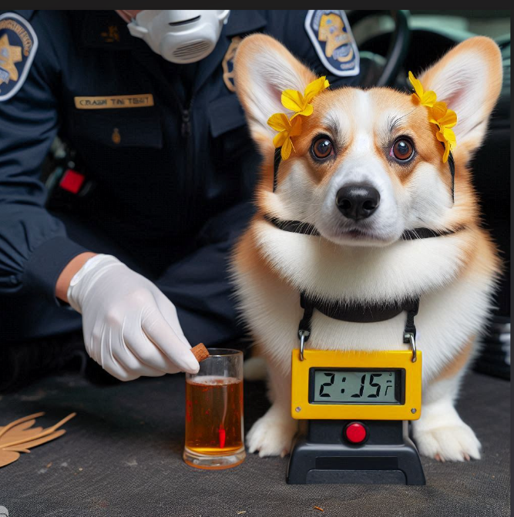
Topic 2
Priscilla

Slide 7


Talking points-Priscilla (Be sure to customize icons for each talking point)
Planning
Synergize scalable e-commerce
Marketing
Disseminate standardized metrics
Design
Coordinate e-business applications
Strategy
Foster holistically superior methodologies
Launch
Deploy strategic networks with compelling e-business needs

Slide 8
Cut and Paste Chart Below (Priscilla)

Slide 9

Topic 3
Dean

Slide 10
Talking points-Dean (Be sure to customize icons for each talking point)
Planning
Synergize scalable e-commerce
Marketing
Disseminate standardized metrics
Design
Coordinate e-business applications
Strategy
Foster holistically superior methodologies
Launch
Deploy strategic networks with compelling e-business needs

Slide 11
Cut and Paste Chart Below (Dean)

Slide 12

Topic 4
Joseph

Slide 13
Talking points-Joseph (Be sure to customize icons for each talking point)
Planning
Synergize scalable e-commerce
Marketing
Disseminate standardized metrics
Design
Coordinate e-business applications
Strategy
Foster holistically superior methodologies
Launch
Deploy strategic networks with compelling e-business needs

Slide 14
Cut and Paste Chart Below (Joseph)

Slide 15

Thank you
Mirjam Nilsson
mirjam@contoso.com
www.contoso.com

Slide 16
Areas of growth
 | B2B | Supply chain | ROI | E-commerce
Q1 | 4.5 | 2.3 | 1.7 | 5.0
Q2 | 3.2 | 5.1 | 4.4 | 3.0
Q3 | 2.1 | 1.7 | 2.5 | 2.8
Q4 | 4.5 | 2.2 | 1.7 | 70

Slide 17
Business opportunities are like buses. There’s always another one coming.
“
”
Richard Branson

Slide 18
How we get there​
ROI​
Niche markets
Supply chains​
Envision multimedia-based expertise and cross-media growth strategies​ Visualize quality intellectual capital​ Engage worldwide methodologies with web-enabled technologies​ ​
Pursue scalable customer service through sustainable strategies​ Engage top-line web services with cutting-edge deliverables​
Cultivate one-to-one customer service with robust ideas​ Maximize timely deliverables for real-time schemas

Slide 19

Summary
At Contoso, we believe in giving 110%. By using our next-generation data architecture, we help organizations virtually manage agile workflows. We thrive because of our market knowledge and great team behind our product. As our CEO says, “Efficiencies will come from proactively transforming how we do business.”

